Slide 1
Zotero for Citation
Research Management
Matthew Hunter
Digital Scholarship Librarian
FSU Libraries
mhunter2@fsu.edu

Slide 2
Zotero Installation
(instructions also at guides.lib.fsu.edu/zotero/install)
Go to Zotero.org and register for an account
Return to Zotero.org and click the “Download Now” button
  Download & install Zotero 5.0
    (your OS will automatically be detected)
  Download and install the Zotero browser connection
    (your browser will automatically be detected)
Link your Zotero account to the Zotero 5.0 application
  For Windows & Linux Users: Edit > Preferences > Sync > Link Account
  For macOS Users: Zotero > Preferences > Sync > Link Account

Slide 3

Zotero is...

Slide 4
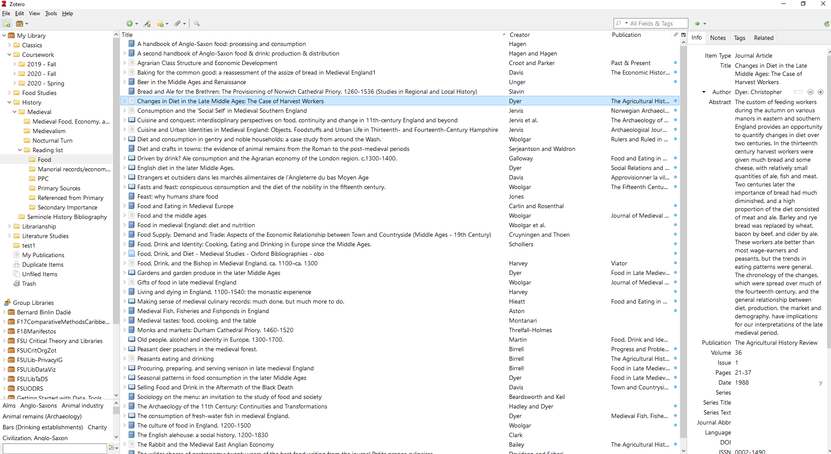
Search
Items
Collections
Metadata
Groups
Tags

Slide 5

Think about your research workflow...
Where do you find your sources?
How do you save them?
Where are they saved?
  (...are they backed up?)
Are they organized?
How do you write your citations?
  How long does it take?
Kimrey, Paul Timothy. What Medical School Is Like -or- Studying for Anatomy. October 24, 2004. Photo. https://www.flickr.com/photos/timkimrey/600332795/.

Slide 6
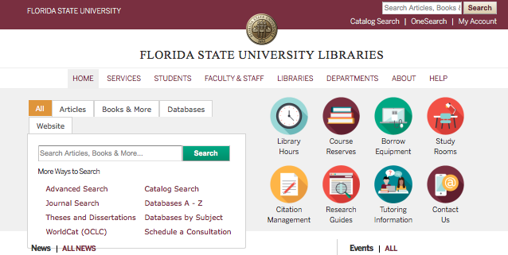





Where do you find your sources?

Slide 7
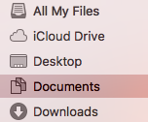
Where are your sources saved?
If you switch computers mid-paper, or need to get to that source you found on the lab computer, can you?
Zotero syncs your local document library (including citations and files) to cloud storage, accessible to any Zotero app or through Zotero.org. If you can connect to the internet, you can access your sources.
What’s more, if a device is synced to your Zotero account, your files are all available offline, too!

Slide 8
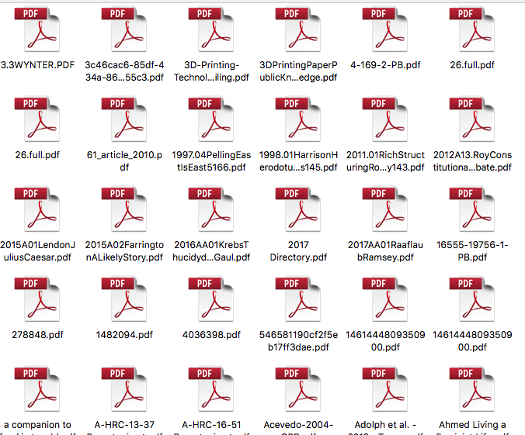
How do you organize your sources?
Once you’ve found your sources, do you just save them as PDFs to your desktop?
Will you still remember what 4-169-2-PB.pdf is in a week?
What about if you take notes on a source?
Zotero allows for full-text PDF capture directly from library search results, in addition to images, audio and video files, snapshots of web pages, and more (metadata included!).

Slide 9
How do you write your citations?
Zotero now comes with plugins for Microsoft Word, Openoffice, and Libreoffice, as well as having Google Docs compatibility!
Cite sources with just few button-clicks & build your bibliography automatically
Zotero is pre-loaded with the latest major styles such as APA 7, MLA 8, Chicago 17, and over 9,000 additional styles are available for download
Open-source code & active development community also provides plugins for BibLaTeX, Wordpress, Omeka, and others!

Slide 10




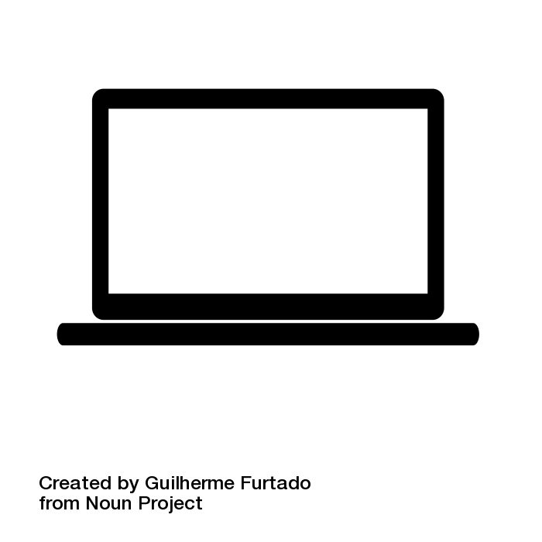

Zotero
Icon credits:
“Marketing Research” by Ismael Ruiz; “Laptop” by Guilherme Furtado; “Cloud Server” by Nick Bluth; “Word Document” by Ryan Beck; “Internet” by Chameleon Design. All from Noun Project

Slide 11
Zotero Interface
Library - where everything lives
Groups - shared libraries
Collection - think “playlist”
  Items can be added/removed without deleting from Zotero completely
  Items can live in multiple collections
Tags - help to filter items, also meta-organization (“to read,” “find pdf”)
Search - basic and advanced
  Searches can be saved as auto-update collections
Library
Items
Search
Search
Collections
Metadata
Groups
Tags

Slide 12
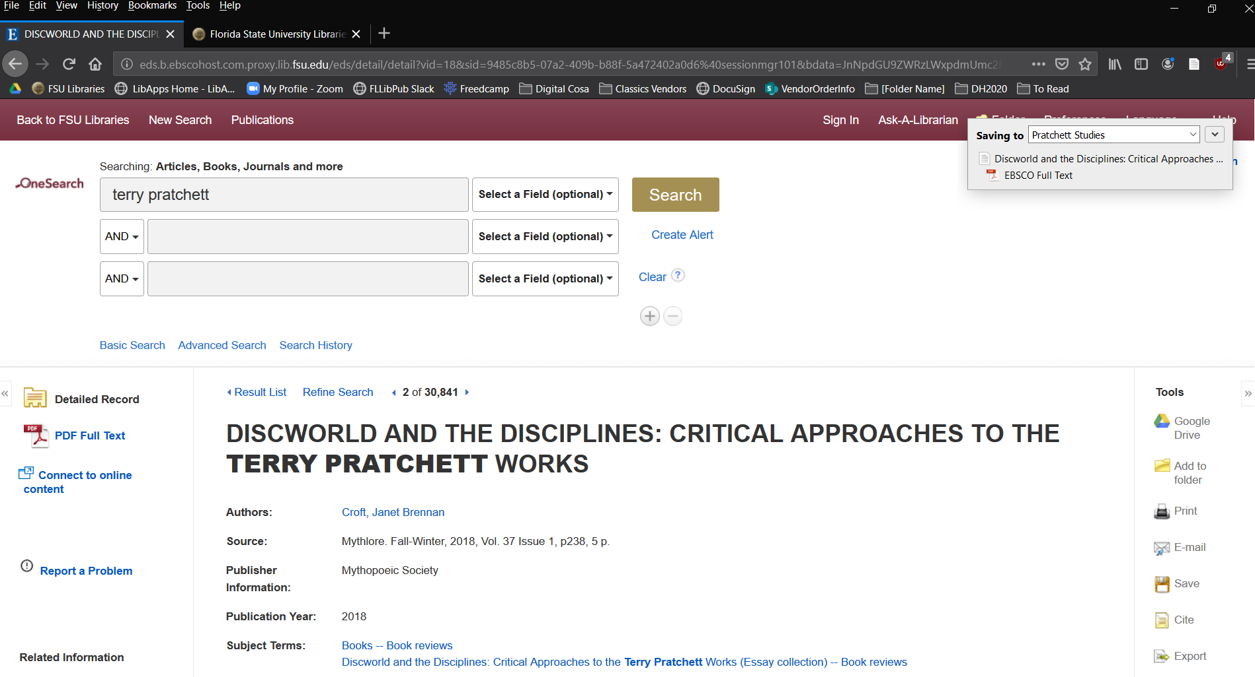
Example: Saving items from Catalog
“Save to Zotero (EBSCOhost*)” - single entry
Saves to your active collection in Zotero - Including the full PDF (if you have access)

Slide 13
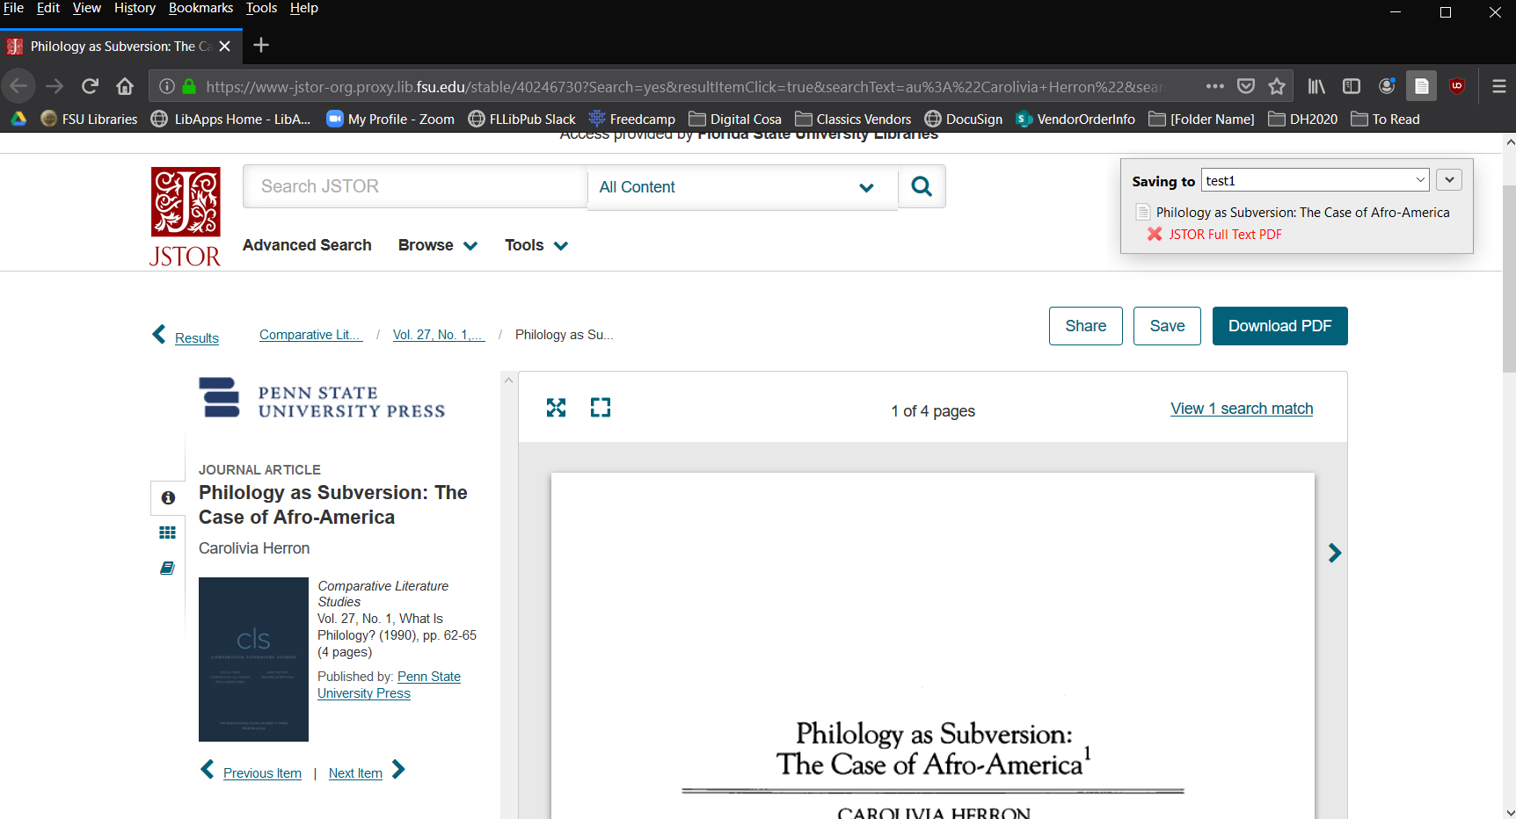
Saving items from database
“Save to Zotero (JSTOR)”
Saves to your active collection in Zotero - Including the full PDF (if you have access*)

Slide 14
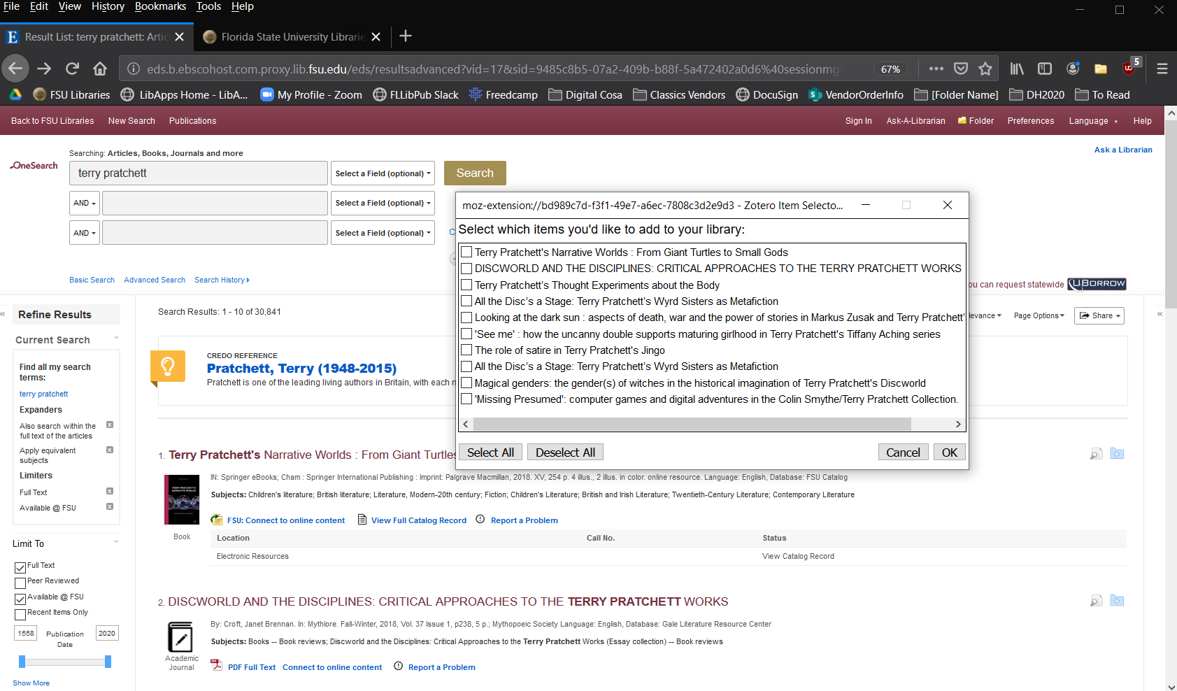
Example: Saving items from Catalog
“Save to Zotero (EBSCOhost)” - results list
Multiple items:
Option to save none, some, or all results. (Should save PDFs too)

Slide 15
Alternatives: Saving references
Zotero can add items automatically via DOI, ISBN, PMID, BibTex, and RIS
Manual entry is also an option
PDF indexing may allow citation creation from single PDFs
You can drag/drop files into Zotero as either standalone items or attachments
Notes:
PMID: PubMed ID, RIS: Reference Information Systems

Slide 16
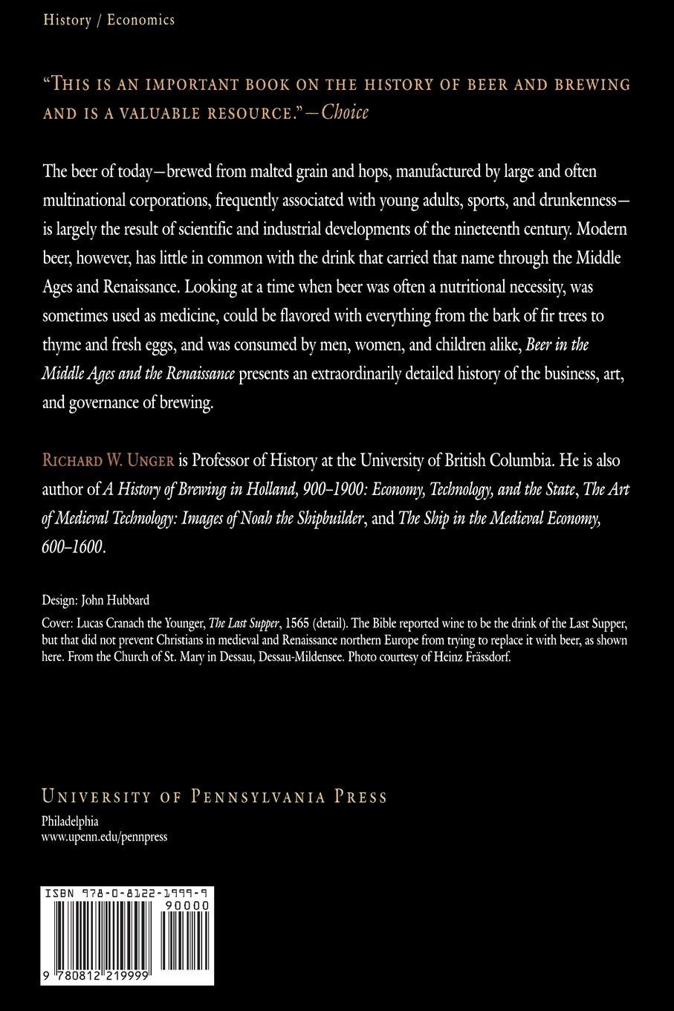
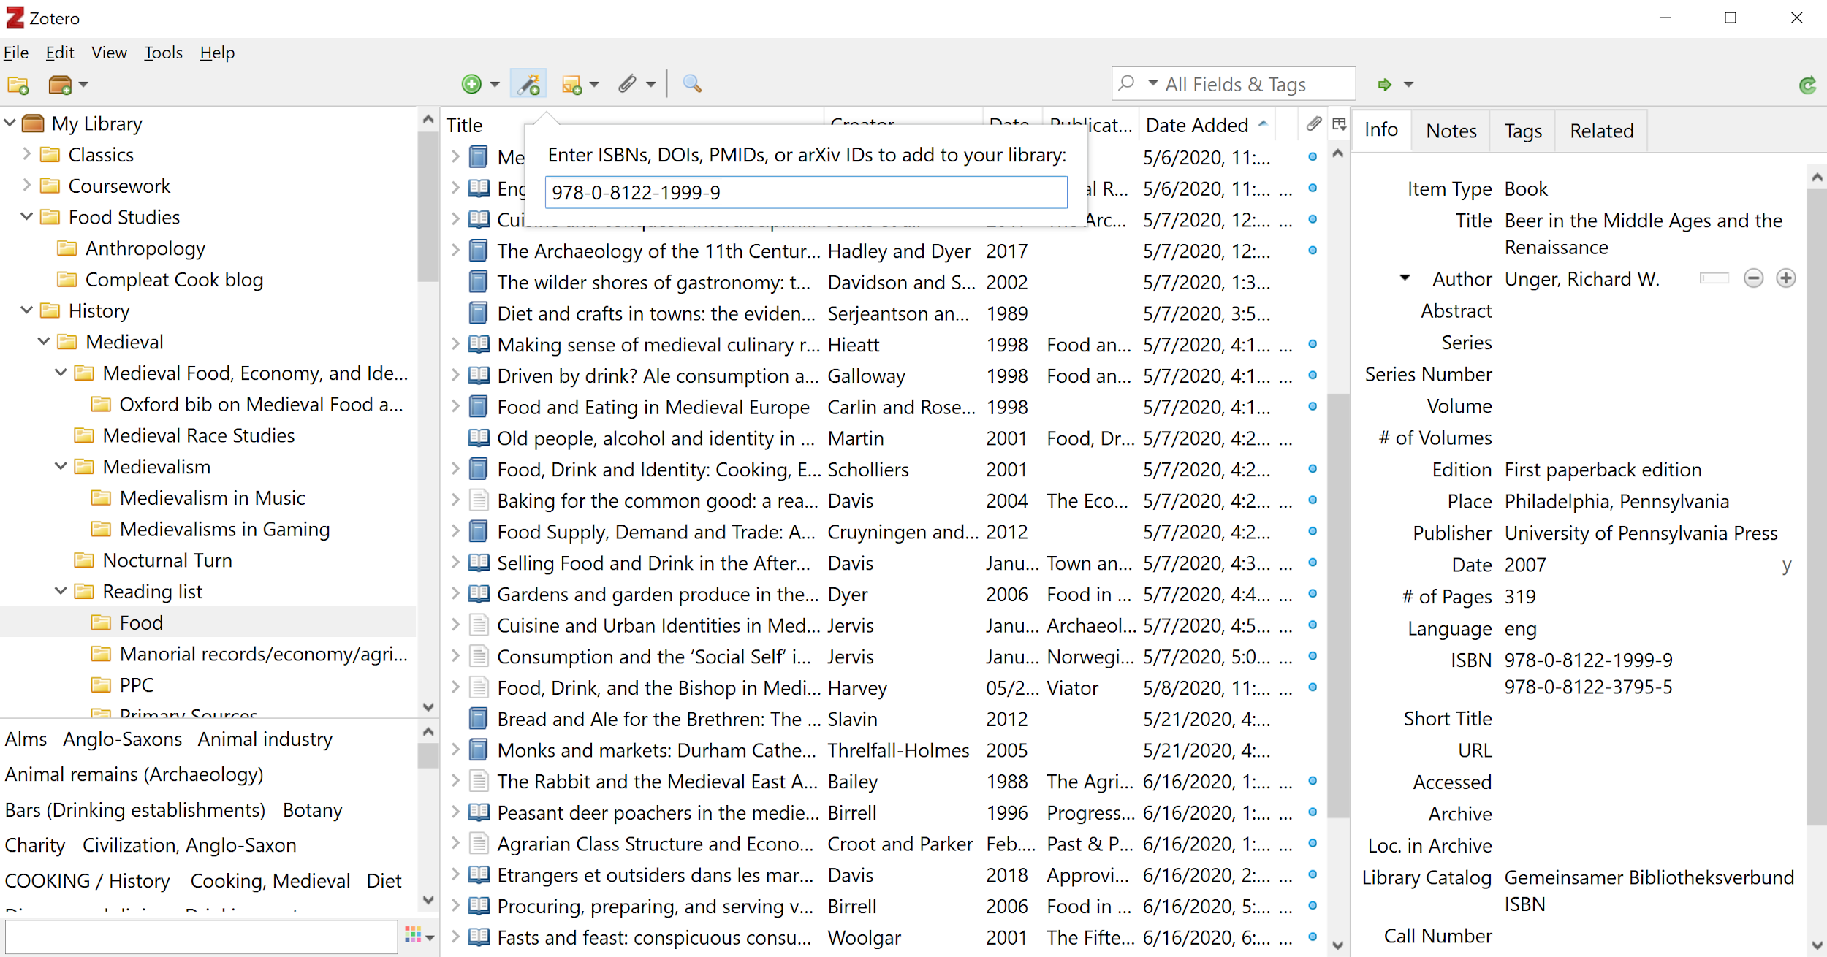
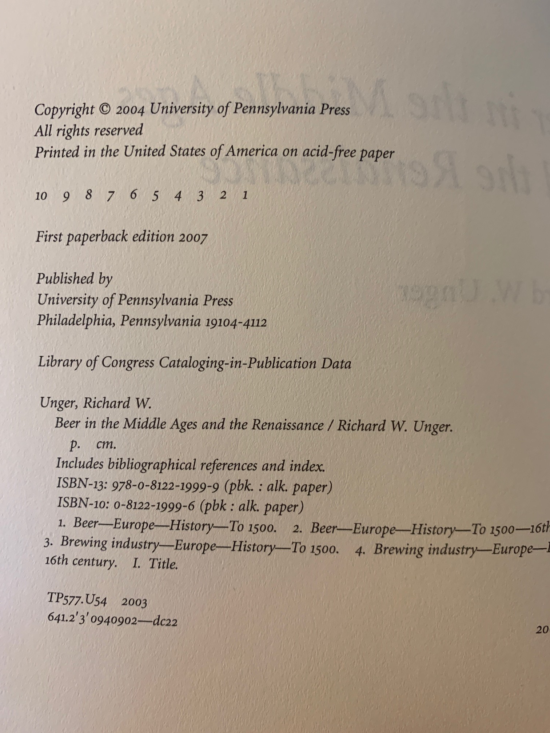
Adding item from DOI/ISBN lookup

Slide 17
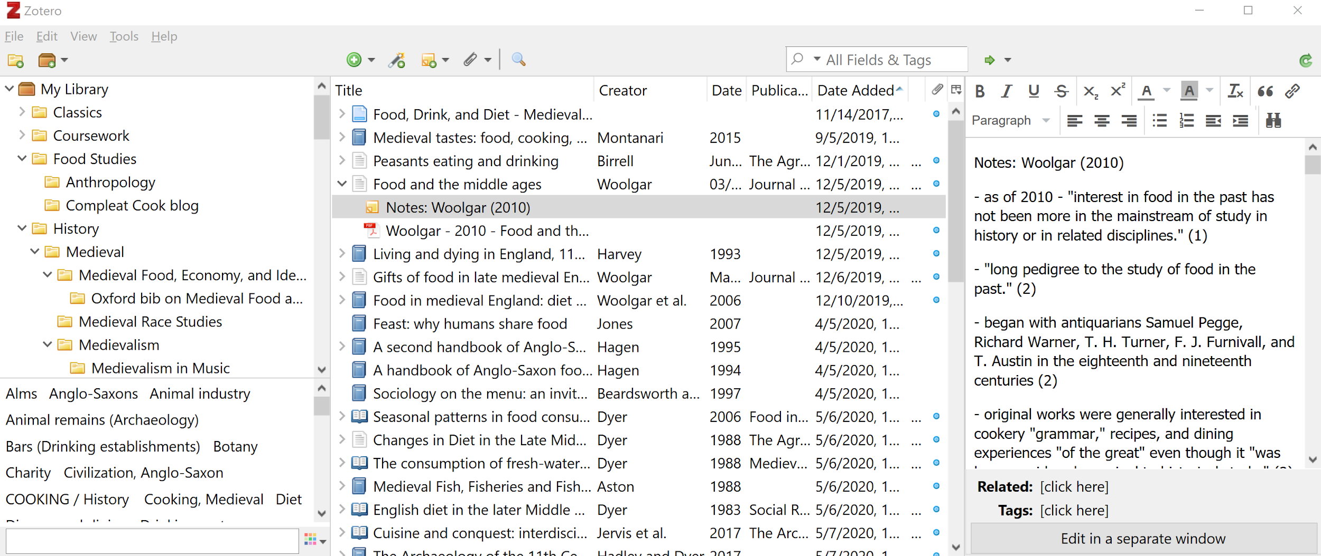

Managing sources & files
Attach local file (or link) to Item entry (PDF, video, audio, image, website, etc.!)
Manual Item entry
Add new Group Library/Feed
Add new Collection
Advanced Search (incl. Indexed PDF text, if available)
Add by Identifier
(“Magic wand” lookup)
Add “Parent” (standalone) or “Child” (attachment) Notes

Slide 18

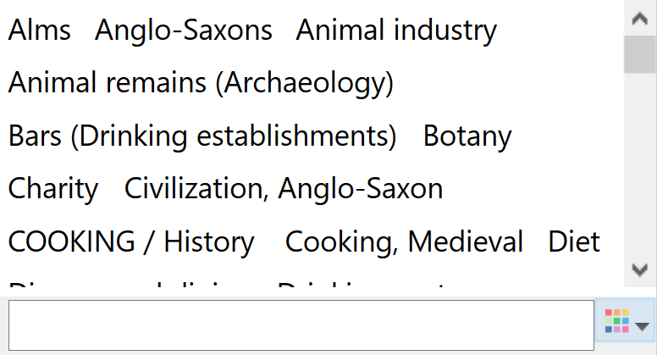
Staying Organized
Sync button/indicator
Add/Edit/View bibliographic info
Add, edit, and organize “child notes”
Create two-way relationships between items
View Tags, search, and filter
Add, edit, and organize Tags

Slide 19
Notes & Attachments

Slide 20
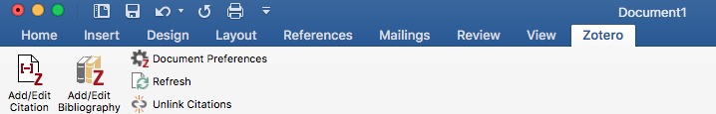
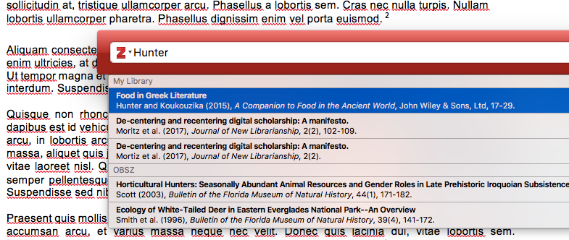
Citing with Zotero
Citation with Zotero is quick, easy, and (almost) automatic.
In-processor Zotero search

Slide 21
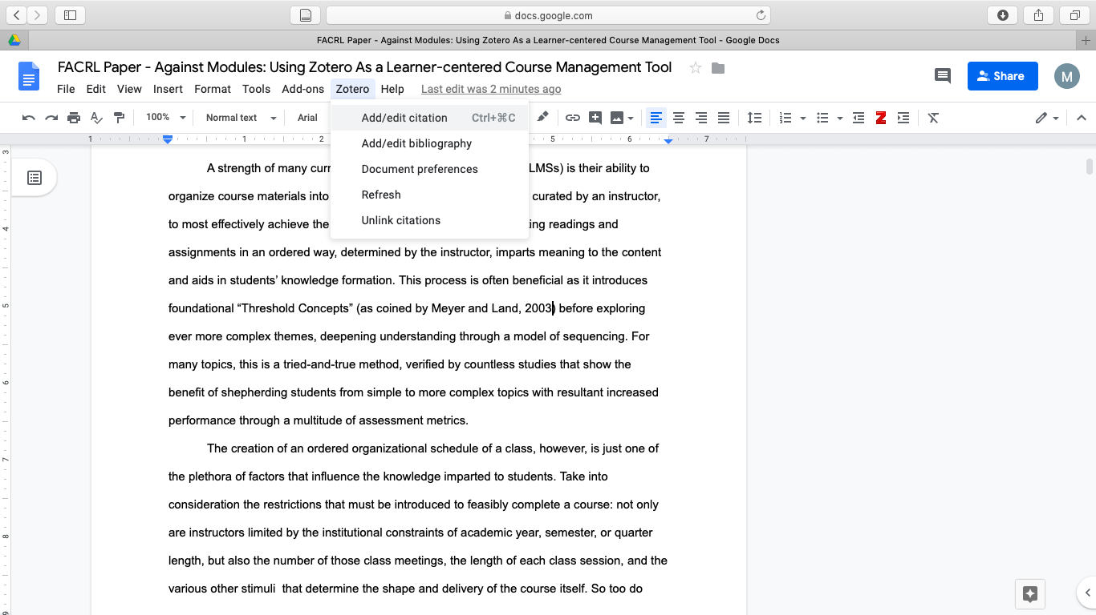
Citing with Zotero - Google Docs
(Zotero must be open in the background)

Slide 22
Citing with Zotero
Automatic ibid., footnotes, order adjustments, and more...
Bibliography automatically selected from citations, auto-generates with 1 click
Most common citation styles included out-of-the-box
Almost 9,000 bibliographic styles available on Zotero.org
Easy to switch between styles!
In a hurry and don’t need full Zotero features?
  Use ZoteroBib (zbib.org) - streamlined web-only bib builder

Slide 23
Final words
300mb free cloud sync storage
Group storage = the group owner’s storage
No 1st-party mobile app exists (coming soon!), and 3rd-party support is spotty
You can always export/import bibliographies to other common citation management systems, so don’t feel “stuck”

Slide 24
Zotero Tips
Always try to find a unique identifier for a source, if possible (DOI, ISBN...)
  One-click save results aren’t always right
Always double-check your metadata right away!
  Easier to catch mistakes while you’re still looking at the source.
Run “Optical Character Recognition” on PDFs before uploading them
Save documents & Sync library often
Organize!

Slide 25
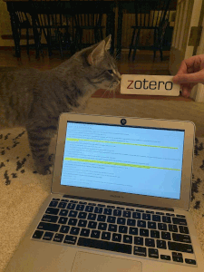
Questions?

